Slide 1
Jenkins Deployment Demo
On AWS using CloudFormation
By Brayan Perera

Slide 2
Outline
Requirements
Solution
Architecture
Infrastructure Provisioning
CI/CD Pipeline
Feedback

Slide 3

Requirements

Slide 4
Requirements
Infrastructure to be provisioned via Cloudformation
Jenkins Server to be created and Configured from scratch.
Demo App should connect to a DB and serve the user information available in the user table.

Slide 5

Solution

Slide 6
Solution
Infrastructure Provisioning
Cloudformation
Provision all AWS services
VPC
Jenkins EC2
App EC2
ELB and resources
ECR
Ansible
Deploy application to the EC2 instance
CI/CD Pipeline
Jenkins Pipelines
Jenkinsfile based pipeline within the demo-app
Build the Docker Image and push to ECR
Deploy Application to target EC2 instance via Ansible Playbook

Slide 7

Architecture

Slide 8








Deployment Architecture
AWS Cloud
Region
Availability Zone 1
Availability Zone 2
Private subnet 1
Private subnet 2
ECR
Jenkins
App
GitHub Repo
Public subnet 1
Public subnet 2
Bastion
ALB

Slide 9

Infrastructure Provisioning

Slide 10
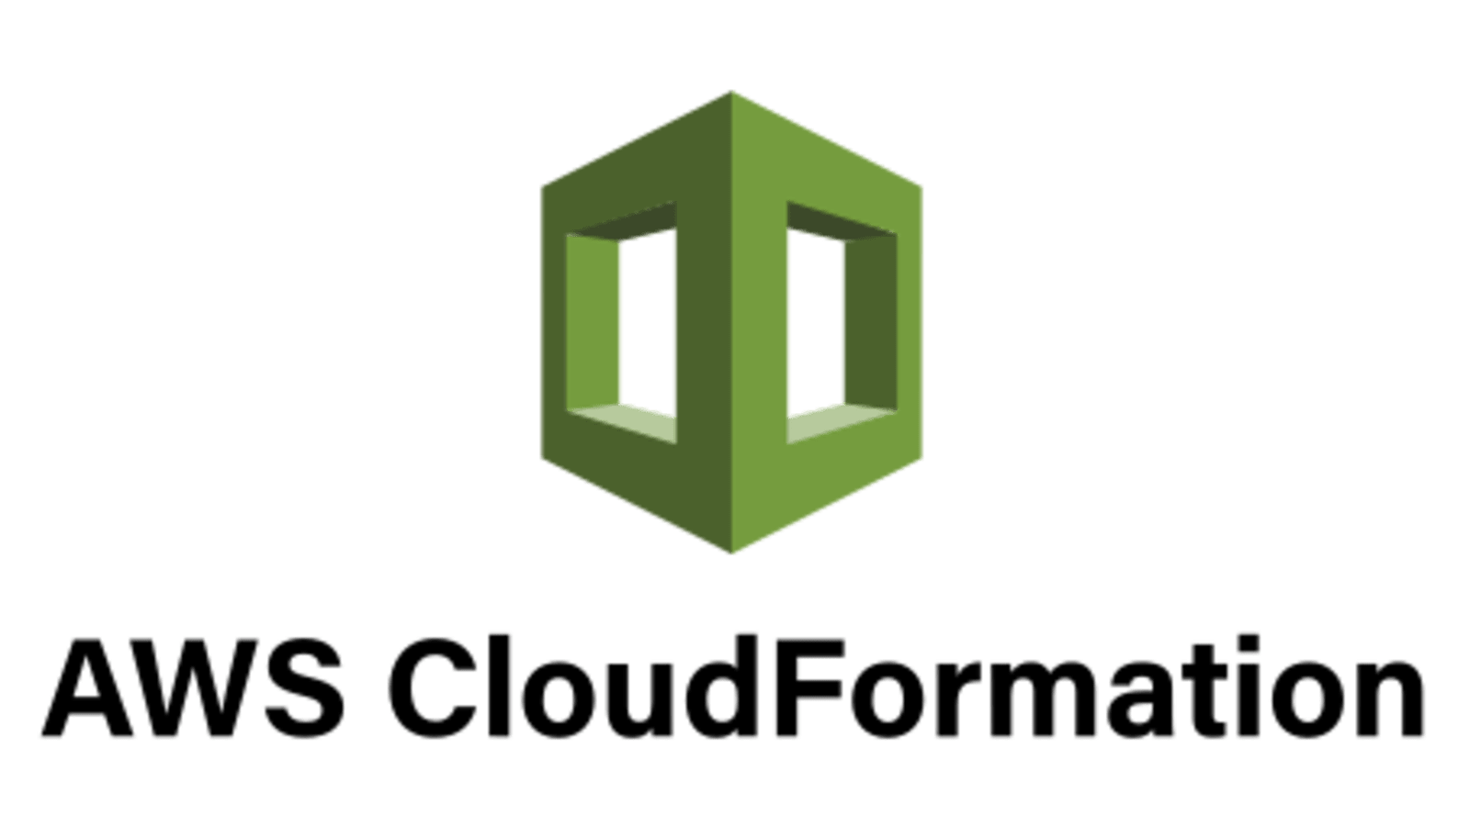
CloudFormation Workflow
IAM
Create IAM Roles and Instance profiles
VPC
Create VPC and Subnets
ECR
Create ECR
EC2
Create EC2 Instances
ALB
Create Application Loadbalancer
Security Groups
Create Security Groups for ELB and EC2

Slide 11
Create IAM Resources
Pre-Requisites
Role for Jenkins Host
Push and Fetch ECR container images
IAM User is already created
Role For App Host
Fetch ECR container images
IAM Instance Profile for Jenkins Host
IAM Instance Profile for App Host

Slide 12
Create VPC resources
Public Subnets
Private Subnets
Internet GW
Elastic IPs for NatGWs
NatGW per private subnet
public route table
Route table per private subnet
route for public route table
route for private route tables
route table association for public subnets
route table association for private subnets

Slide 13
Create Security Groups
ALB
Bastion Host
Port 22 to 0.0.0.0/0
Port 80 and 443 to 0.0.0.0/0
Jenkins Host
Port 22 to Bastion Host SG
Port 8080 to ALB SG
App Host
Port 22 to Bastion Host SG
Port 8000 to ALB SB
Port 22 to Jenkins Host SG

Slide 14
EC2 Provisioning
Create AWS Security Group for the EC2 instances
2
Create Bastion Host
3
Create Jenkin Host
4
Create App host
5
Install docker and docker-compose
Install Jenkins
Install docker and docker-compose
Pre-Requisites
1
Already available keypair

Slide 15
ALB Provisioning
Create AWS Security Group for the ALB
Create Application loadbalancer
Create a target group for the application service
Create ALB listner pointing to the target group
Jenkins Access
Application Access
Pre-Requisites
Already available Domain Name

Slide 16

CI/CD Pipeline

Slide 17

CI/CD Pipeline Flow
Git
User Push a change
Jenkins
Invoke pipeline based on Jenkinsfile
ECR
Build Image and Push to ECR
Docker Compose
Recreate containers based on the image changes
Ansible
Run playbook to deploy docker-compose changes

Slide 18

Feedback

Slide 19

Thank You

